Slide 1

Manfred Lum 214412L

Slide 2
Table of content
Architecture diagram
Sandbox creation
Project Estimate Cost

Slide 3











Architecture diagram
AWS Cloud
Region – US-east-1a
Availability Zone
VPC_12L 10.12.0.0/16
Amazon Elastic Block Store (Amazon EBS)
Amazon Elastic Block Store (Amazon EBS)
Public subnet 10.91.0.0/24
Security group
Elastic IP address
35.175.99.235
Attached as
Root volume
NAT gateway
10-GB volume
Instance
Attached as
Storage volume
Private subnet 10.12.1.0/24
8-GB volume

Slide 4
Sandbox Creation

Slide 5
Creating VPC
Creating VPC_12L: -Creation of Public and Private subnet with proper IP address
-Create NAT Gateway

Slide 6
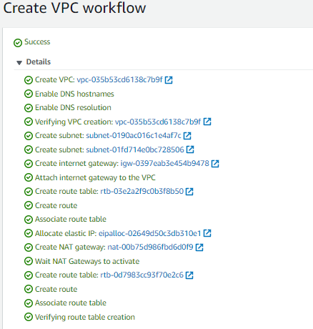
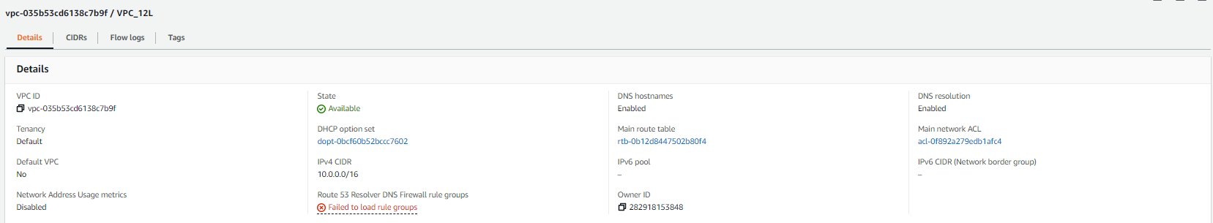
Finalizing VPC
- Edited VPC name

Slide 7
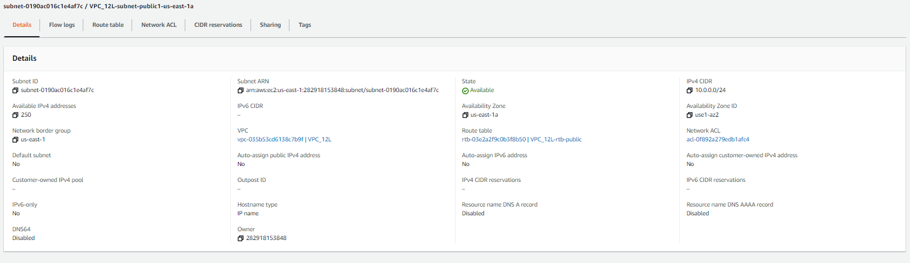
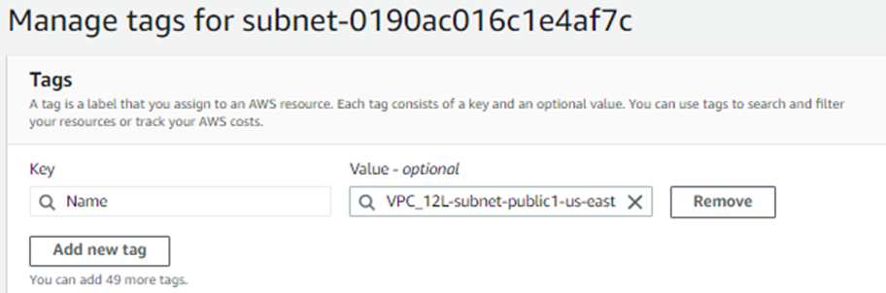
Editing Public Subnet
Before :
name is wrong
Tag is missing

Slide 8
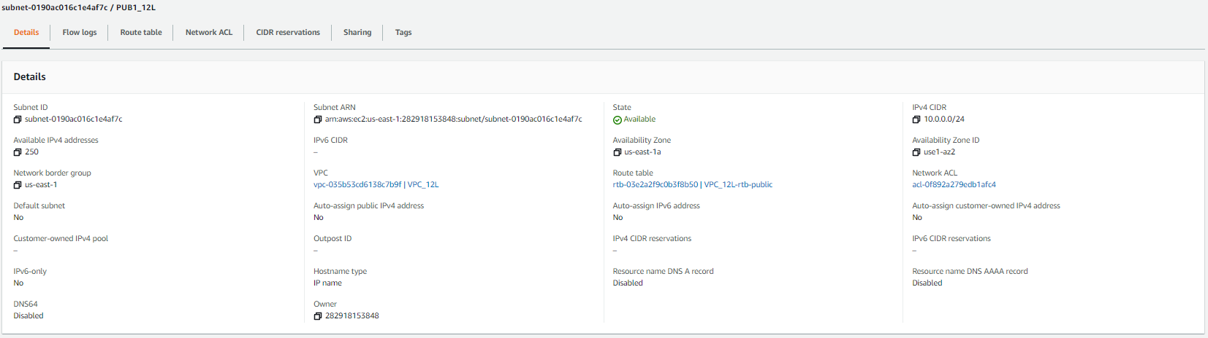
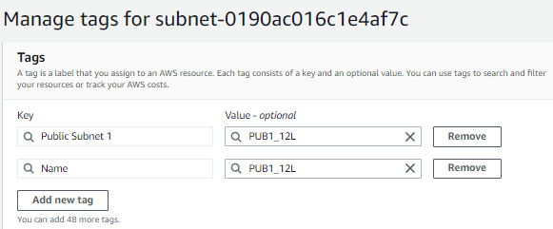
After:
Edited Public subnet name to PUB1_12L
Added Public subnet tag to Key : Public Subnet 1 | Value : PUB1_12L

Slide 9
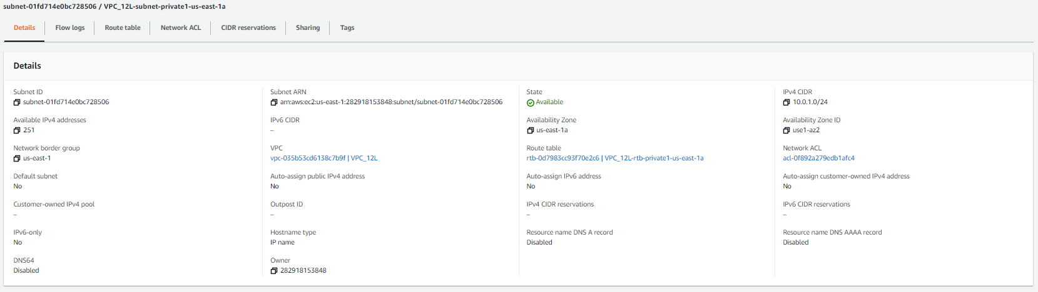
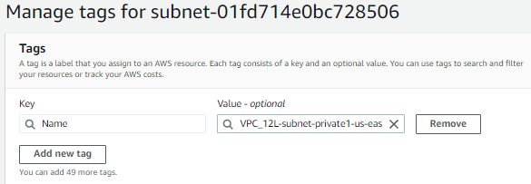
Editing Private Subnet
Before :
name is wrong
Tag is missing

Slide 10
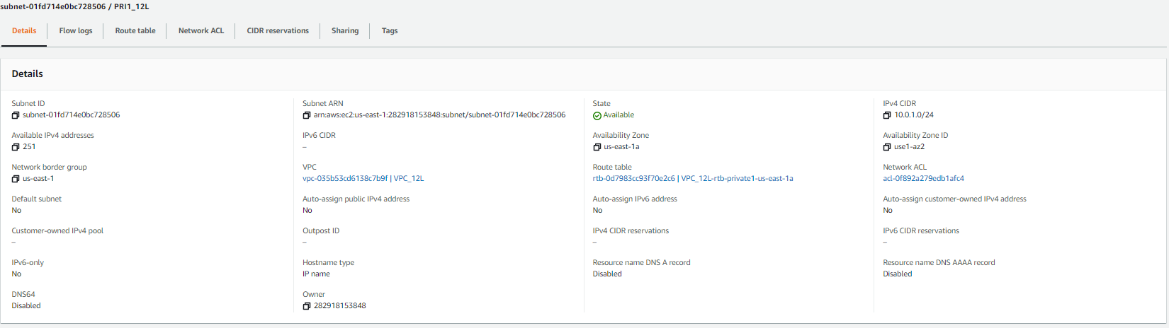
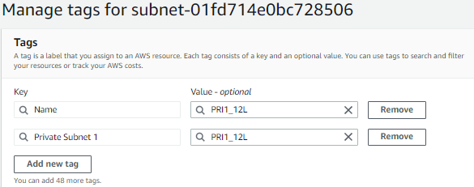
After:
Edited Private subnet name to PRI1_12L
Added Public subnet tag to Key : Private Subnet 1 | Value : PRI1_12L

Slide 11
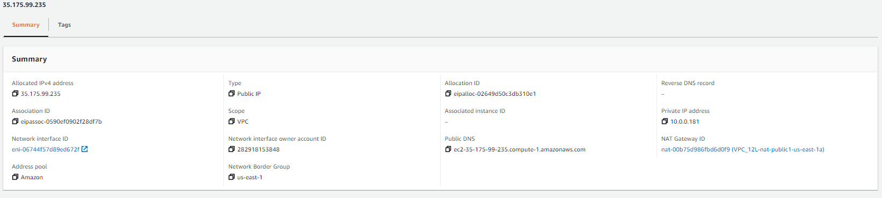
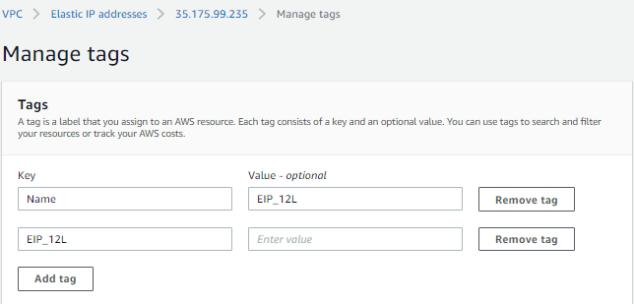
Elastic IP

Slide 12
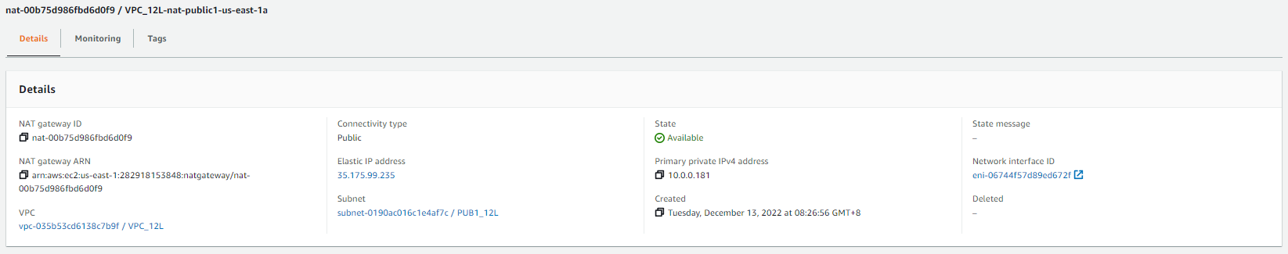
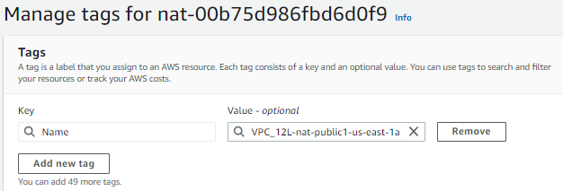
Editing NAT Gateway
Before:
Name wrong
Wrong tag

Slide 13
Editing NAT Gateway
After:
Edited the name
Added and edited the tag

Slide 14
Creating Security Group
Security Group allows SSH and HTTP
VPC_12L ID

Slide 15
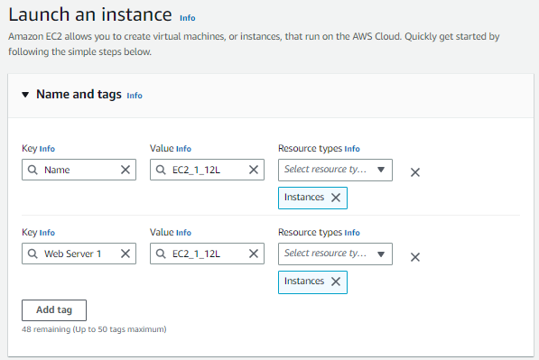
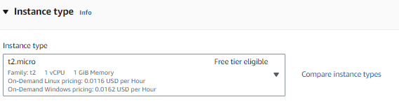
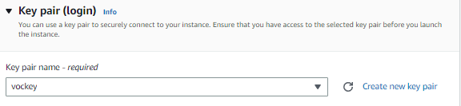
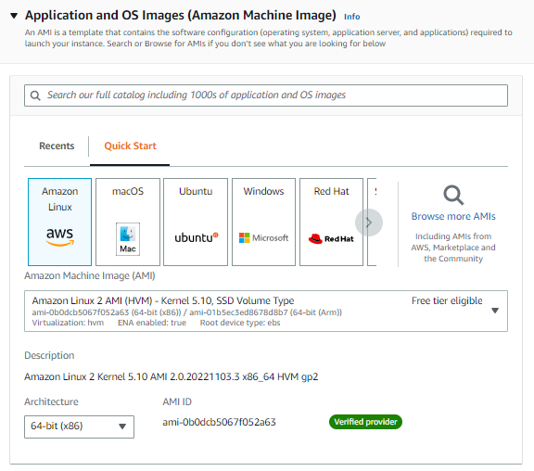
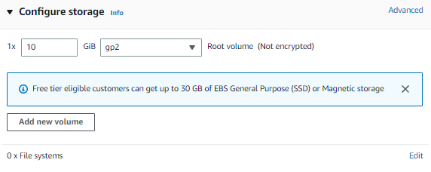
Creating EC2
Web Server 1 12L

Slide 16
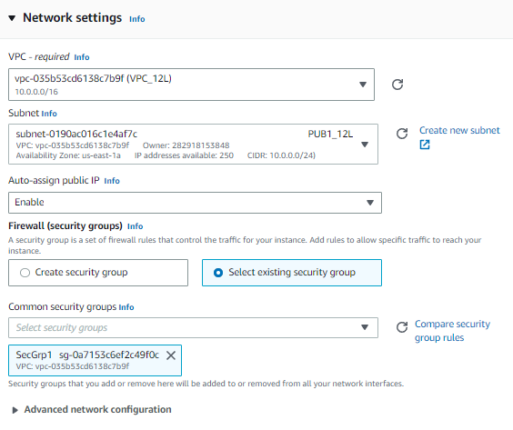
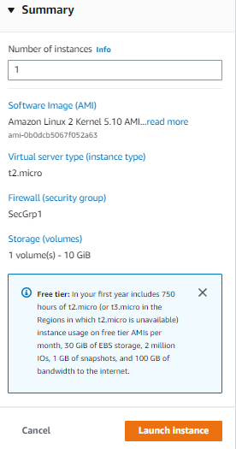
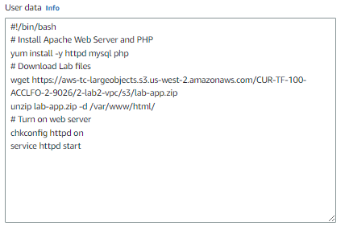
Creating EC2
Install PHP in EC2

Slide 17
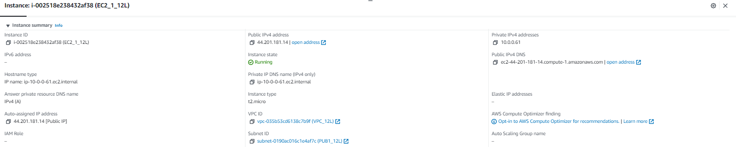
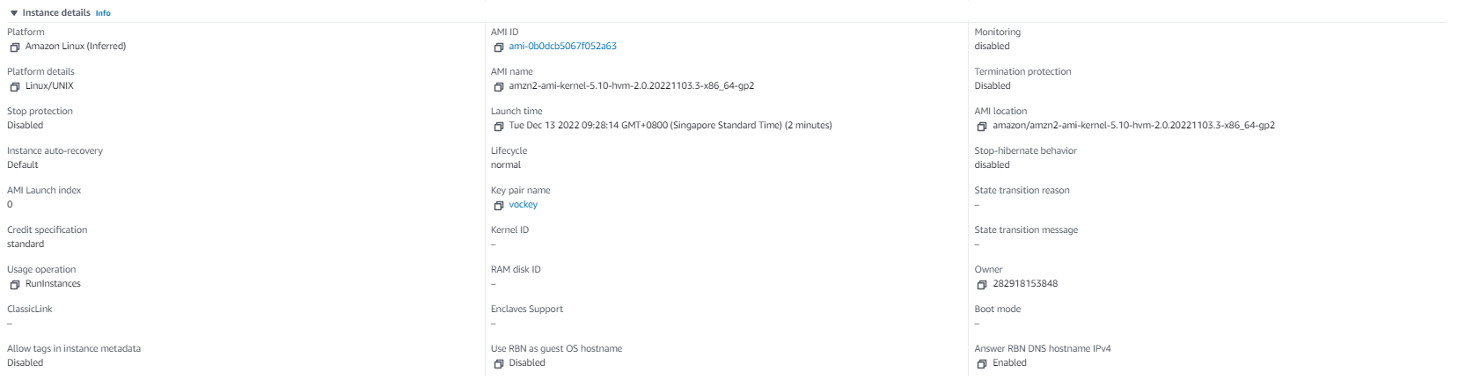
Checking EC2

Slide 18
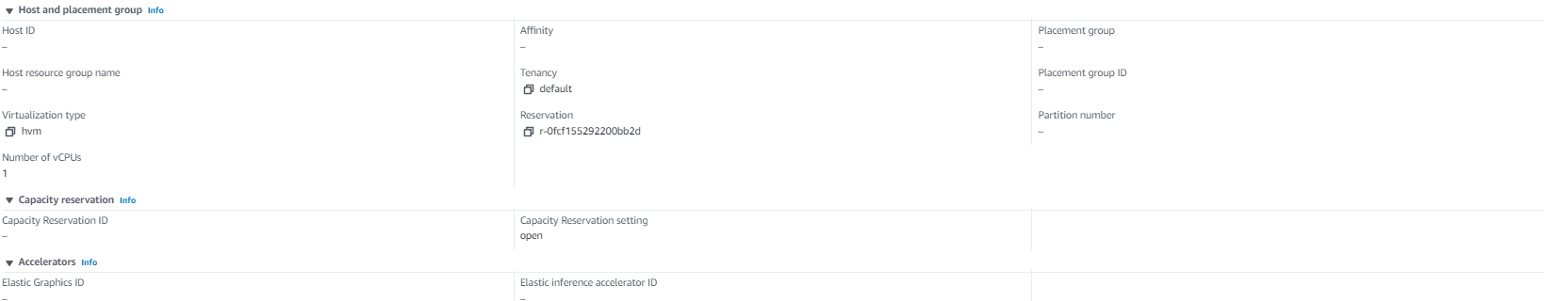
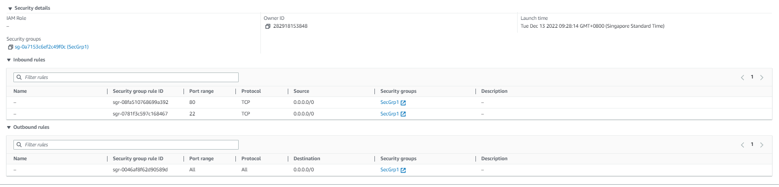
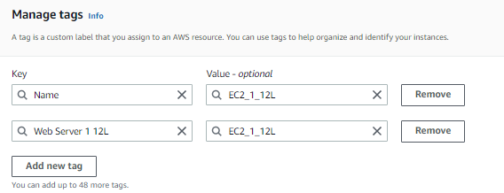
Checking EC2

Slide 19
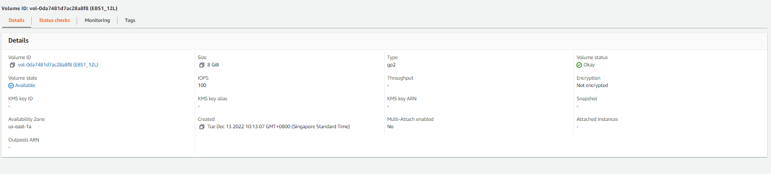
Creating EBS

Slide 20
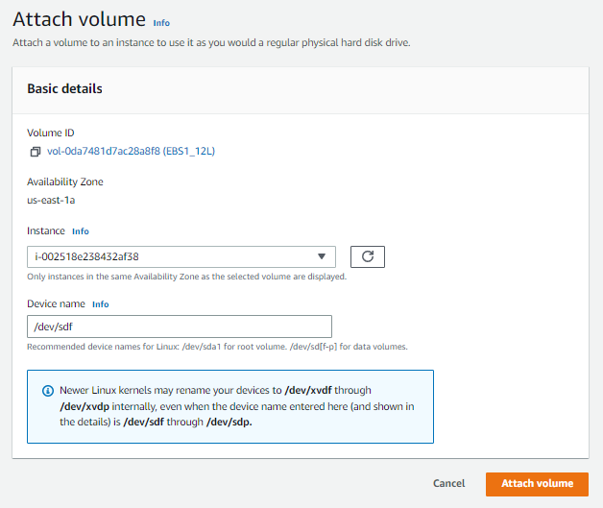
Attach EBS to EC2

Slide 21
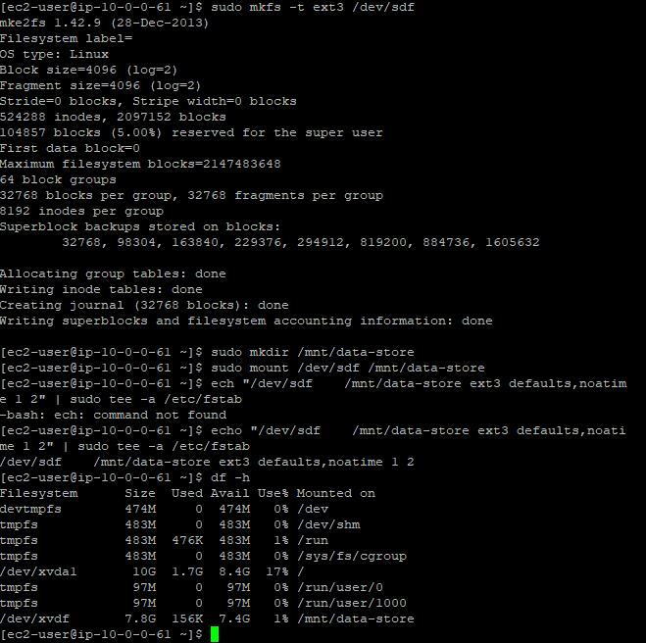
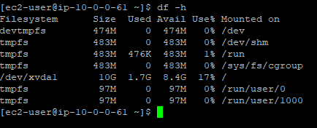
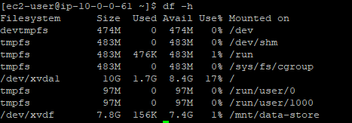
Mounting EBS on EC2
Before:
commands
After :

Slide 22
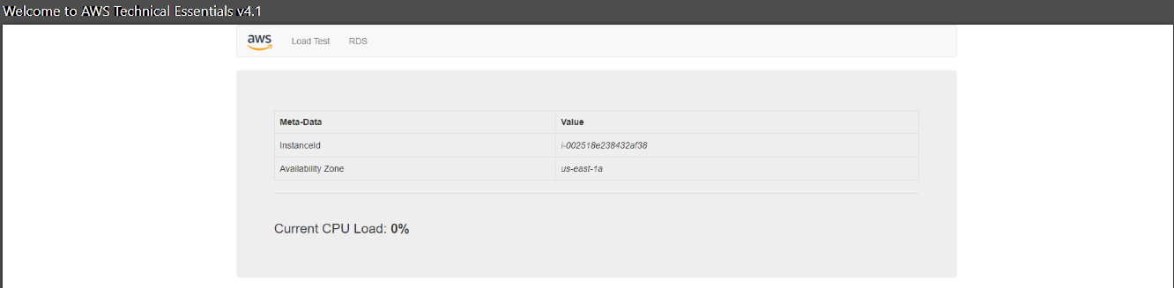
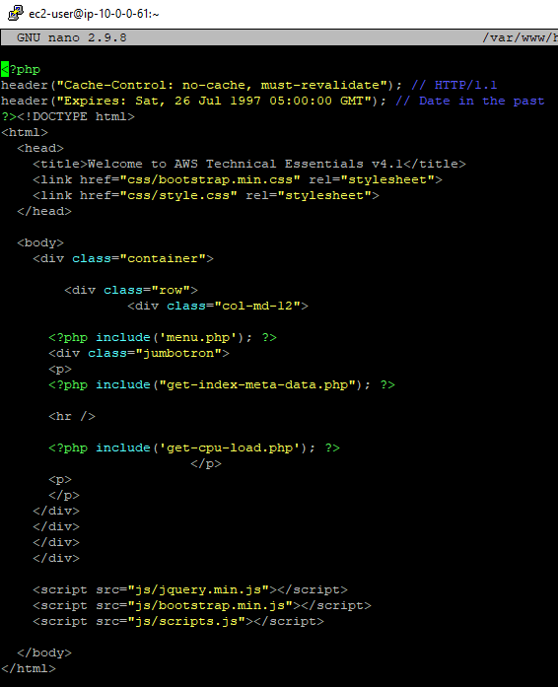
Editing HTML
Before:

Slide 23
Editing HTML
After:

Slide 24
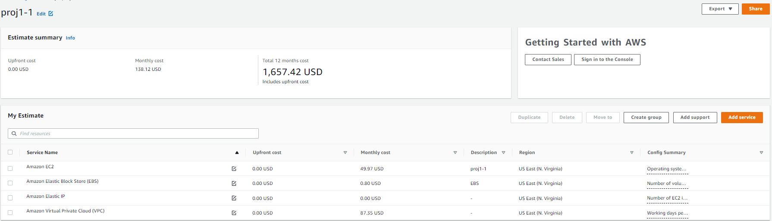
Project Estimate Cost

